Slide 1

Chapter Nine
Predicate logic

Slide 2
Learning objectives.
9.1 Introduction
9.2 Well-formed Formulas for First-order Predicate Logic-syntax Rules
9.3 Satisfiable, unsatisfiable and valid WFF
9.4 Equivalence
9.5 Computable functions and predicate logic
9.6 Resolution
9.7 Conversion to clause form
9.7.1 Algorithm
9.7.2 Example
9.8 First-order logic
9.9 Knowledge engineering of FOL
9.10 Unification
9.11 Natural Deduction
After this chapter , students will be able to :
Understand the usage of first-order logic.
Use of syntax and semantic of first-order logic.

Slide 3
Introduction
9.1 Introduction
9.2 Well-formed Formulas for First-order Predicate Logic-syntax Rules
9.3 Satisfiable, unsatisfiable and valid WFF
9.4 Equivalence
9.5 Computable functions and predicate logic
9.6 Resolution
9.7 Conversion to clause form
9.7.1 Algorithm
9.7.2 Example
9.8 First-order logic
9.9 Knowledge engineering of FOL
9.10 Unification
9.11 Natural Deduction
The propositional logic is not powerful enough to represent all the types of assertions that are used in computer science and mathematics, or to express certain types of relationship between propositions such as equivalence.
For example, the assertion “x is greater than 1”, where x is variable, is not a proposition because you cannot tell whether it is true or false unless you know the value of x. Thus, the propositional logic cannot deal with such sentences
Thus, we need more powerful logic to deal with these and other problems. The predicate logic is one of such logic and it addresses these issues among these.

Slide 4
Propositional logic is not expressive enough
9.1 Introduction
9.2 Well-formed Formulas for First-order Predicate Logic-syntax Rules
9.3 Satisfiable, unsatisfiable and valid WFF
9.4 Equivalence
9.5 Computable functions and predicate logic
9.6 Resolution
9.7 Conversion to clause form
9.7.1 Algorithm
9.7.2 Example
9.8 First-order logic
9.9 Knowledge engineering of FOL
9.10 Unification
9.11 Natural Deduction
Suppose we want to capture the knowledge that
Anyone standing in the rain will get wet.
and then use this knowledge. For example, suppose we also learn that
Jan is standing in the rain.
We'd like to conclude that Jan will get wet. But each of these sentences would just be a represented by some proposition, say P, Q and R. What relationship is there between these propositions? We can say
P /\ Q → R
Then, given P /\ Q, we could indeed conclude R. But now, suppose we were told
Pat is standing in the rain.

Slide 5
Propositional logic is not expressive enough (cont’)
9.1 Introduction
9.2 Well-formed Formulas for First-order Predicate Logic-syntax Rules
9.3 Satisfiable, unsatisfiable and valid WFF
9.4 Equivalence
9.5 Computable functions and predicate logic
9.6 Resolution
9.7 Conversion to clause form
9.7.1 Algorithm
9.7.2 Example
9.8 First-order logic
9.9 Knowledge engineering of FOL
9.10 Unification
9.11 Natural Deduction
We'd like to be able to conclude that Pat will get wet, but nothing we have stated so far will help us do this
The problem is that we aren't able to represent any of the details of these propositions
It's the internal structure of these propositions that make the reasoning valid.
But in propositional calculus we don't have anything else to talk about besides propositions!
A more expressive logic is needed
Predicate logic (occasionally referred to as First-order logic (FOL))

Slide 6
9.1 Introduction
9.2 Well-formed Formulas for First-order Predicate Logic-syntax Rules
9.3 Satisfiable, unsatisfiable and valid WFF
9.4 Equivalence
9.5 Computable functions and predicate logic
9.6 Resolution
9.7 Conversion to clause form
9.7.1 Algorithm
9.7.2 Example
9.8 First-order logic
9.9 Knowledge engineering of FOL
9.10 Unification
9.11 Natural Deduction
What is a predicate?
To cope with deficiencies of propositional logic, we introduce two new following features: predicate and quantifiers. A predicate is a verb phrase template that describes a property of objects, or relationship among objects represented by the variables
For example, the sentences “The car Tom is driving is blue”, “The sky is blue”. The phrase “is blue” is a predicate and it describes the property of being blue.
Quantifiers
Universal quantification corresponds to conjunction “and” in that (∀x) P(x) means that P holds for all values of x in the domain associated with that variable.
For example: (∀x) dolphin (x) → mammal (x)

Slide 7
9.1 Introduction
9.2 Well-formed Formulas for First-order Predicate Logic-syntax Rules
9.3 Satisfiable, unsatisfiable and valid WFF
9.4 Equivalence
9.5 Computable functions and predicate logic
9.6 Resolution
9.7 Conversion to clause form
9.7.1 Algorithm
9.7.2 Example
9.8 First-order logic
9.9 Knowledge engineering of FOL
9.10 Unification
9.11 Natural Deduction
2. Existential quantification corresponds to disjunction (“or”) in that (∃x) P(x) means that P holds for some value of x in the domain associated with that variable.
For example: (∃x) mammal (x) ∧ lays-eggs (x).
3. Universal quantifiers are usually used with “implies” to form “IF–THEN rules”.
For example: (∀x) student(x) → smart(x) means “all students are smart”.
4. Existential quantifiers are usually used with “and” to specify a list of properties or facts about an individual.
For example: (∃x) student (x) ∧ smart (x) implies that “there is a student who is smart”.

Slide 8
9.1 Introduction
9.2 Well-formed Formulas for First-order Predicate Logic-syntax Rules
9.3 Satisfiable, unsatisfiable and valid WFF
9.4 Equivalence
9.5 Computable functions and predicate logic
9.6 Resolution
9.7 Conversion to clause form
9.7.1 Algorithm
9.7.2 Example
9.8 First-order logic
9.9 Knowledge engineering of FOL
9.10 Unification
9.11 Natural Deduction
5. A common mistake is to represent this English sentence as the FOL sentence:
For example: (∃x) student (x) →smart (x).
6. Switching the order of universal quantifiers does not change the meaning:
(∀x) (∀ y) P(x, y) is logically equivalent to (∀ y) (∀ x) P(x, y).
7. Switching the order of universals and existential does change the meaning.

Slide 9
9.1 Introduction
9.2 Well-formed Formulas for First-order Predicate Logic-syntax Rules
9.3 Satisfiable, unsatisfiable and valid WFF
9.4 Equivalence
9.5 Computable functions and predicate logic
9.6 Resolution
9.7 Conversion to clause form
9.7.1 Algorithm
9.7.2 Example
9.8 First-order logic
9.9 Knowledge engineering of FOL
9.10 Unification
9.11 Natural Deduction
A term (denoting real-world object) is a constant symbol, a variable symbol, or a function.
For example, father-of ( ). For example, x and f (x1, x2, … xn) are terms, where each xi is a term.
A atom (which has value true or false) is either an n-place predicate of n terms or, if P and Q are atoms, then ⌐ P, P ∨ Q, P ∧ Q, P → Q, P ↔ Q are atoms.
A well-formed formula (WFF) is a sentence containing no “free” variable, i.e., all the variables are “bound” by universal or existential quantifiers.

Slide 10
Objects in Predicate Logic
9.1 Introduction
9.2 Well-formed Formulas for First-order Predicate Logic-syntax Rules
9.3 Satisfiable, unsatisfiable and valid WFF
9.4 Equivalence
9.5 Computable functions and predicate logic
9.6 Resolution
9.7 Conversion to clause form
9.7.1 Algorithm
9.7.2 Example
9.8 First-order logic
9.9 Knowledge engineering of FOL
9.10 Unification
9.11 Natural Deduction
Constants
Names of specific objects
E.g. doreen, gord, william, 32
Functions
Map objects to objects
E.g. father(doreen), age(gord), max(23,44)
Variables
For statements about unidentified objects or general statements
E.g. x, y, z, …

Slide 11
Terms
9.1 Introduction
9.2 Well-formed Formulas for First-order Predicate Logic-syntax Rules
9.3 Satisfiable, unsatisfiable and valid WFF
9.4 Equivalence
9.5 Computable functions and predicate logic
9.6 Resolution
9.7 Conversion to clause form
9.7.1 Algorithm
9.7.2 Example
9.8 First-order logic
9.9 Knowledge engineering of FOL
9.10 Unification
9.11 Natural Deduction
Terms represent objects
The set of terms is inductively defined by the following rules:
Constants: Any constant is a term
Variables: Any variable is a term
Functions: Any expression f(t1,…,tn) of n arguments (where each argument is a term and f is a function of arity n) is a term
Terms without variables are called ground terms
Examples:
c
f(c)
g(x,x)
g(f(c), g(x,x))

Slide 12
Predicate Symbols and Signatures
9.1 Introduction
9.2 Well-formed Formulas for First-order Predicate Logic-syntax Rules
9.3 Satisfiable, unsatisfiable and valid WFF
9.4 Equivalence
9.5 Computable functions and predicate logic
9.6 Resolution
9.7 Conversion to clause form
9.7.1 Algorithm
9.7.2 Example
9.8 First-order logic
9.9 Knowledge engineering of FOL
9.10 Unification
9.11 Natural Deduction
Predicate symbols represent relations between zero or more objects
The number of objects define a predicate‘s aritiy
Examples:
Likes(george, kate)
Likes(x,x)
Likes(joe, kate, susy)
Friends (father_of(david), father_of(andrew))
Signature: A signature is a collection of constants, function symbols and predicate symbols with specified arities

Slide 13
Connectives
9.1 Introduction
9.2 Well-formed Formulas for First-order Predicate Logic-syntax Rules
9.3 Satisfiable, unsatisfiable and valid WFF
9.4 Equivalence
9.5 Computable functions and predicate logic
9.6 Resolution
9.7 Conversion to clause form
9.7.1 Algorithm
9.7.2 Example
9.8 First-order logic
9.9 Knowledge engineering of FOL
9.10 Unification
9.11 Natural Deduction
FOL formulas are joined together by logical operators to form more complex formulas (just like in propositional logic)
The basic logical operators are the same as in propositional logic as well:
Negation: ¬p („it is not the case that p“)
Conjunction: p ∧ q („p and q“)
Disjunction: p ∨ q („p or q“)
Implication: p → q („p implies q“ or “q if p“)
Equivalence: p ↔ q („p if and only if q“)

Slide 14
Quantifiers
9.1 Introduction
9.2 Well-formed Formulas for First-order Predicate Logic-syntax Rules
9.3 Satisfiable, unsatisfiable and valid WFF
9.4 Equivalence
9.5 Computable functions and predicate logic
9.6 Resolution
9.7 Conversion to clause form
9.7.1 Algorithm
9.7.2 Example
9.8 First-order logic
9.9 Knowledge engineering of FOL
9.10 Unification
9.11 Natural Deduction
Two quantifiers: Universal (∀) and Existential (∃)
Allow us to express properties of collections of objects instead of enumerating objects by name
Apply to sentence containing variable
Universal ∀: true for all substitutions for the variable
“for all”: ∀<variables> <sentence>
Existential ∃: true for at least one substitution for the variable
“there exists”: ∃<variables> <sentence>
Examples:
∃ x: Mother(art) = x
∀ x ∀ y: Mother(x) = Mother(y) → Sibling(x,y)
∃ y ∃ x: Mother(y) = x

Slide 15
Formulas
9.1 Introduction
9.2 Well-formed Formulas for First-order Predicate Logic-syntax Rules
9.3 Satisfiable, unsatisfiable and valid WFF
9.4 Equivalence
9.5 Computable functions and predicate logic
9.6 Resolution
9.7 Conversion to clause form
9.7.1 Algorithm
9.7.2 Example
9.8 First-order logic
9.9 Knowledge engineering of FOL
9.10 Unification
9.11 Natural Deduction
The set of formulas is inductively defined by the following rules:
Preciate symbols: If P is an n-ary predicate symbol and t₁,…,t_{n} are terms then P(t₁,…,t_{n}) is a formula.
Negation: If φ is a formula, then ¬φ is a formula
Binary connectives: If φ and ψ are formulas, then (φ → ψ) is a formula. Same for other binary logical connectives.
Quantifiers: If φ is a formula and x is a variable, then ∀xφ and ∃xφ are formulas.
Atomic formulas are formulas obtained only using the first rule
Example: If f is a unary function symbol, P a unary predicate symbol, and Q a ternary predicate symbol, then the following is a formula:
∀x∀y(P(f(x)) → ¬(P(x)) → Q(f(y), x, x)))

Slide 16
Formulas
9.1 Introduction
9.2 Well-formed Formulas for First-order Predicate Logic-syntax Rules
9.3 Satisfiable, unsatisfiable and valid WFF
9.4 Equivalence
9.5 Computable functions and predicate logic
9.6 Resolution
9.7 Conversion to clause form
9.7.1 Algorithm
9.7.2 Example
9.8 First-order logic
9.9 Knowledge engineering of FOL
9.10 Unification
9.11 Natural Deduction
Any occurrence of a variable in a formulate not in the scope of a quantifier is said to be a free occurrence
Otherwise it is called a bound occurrence
Thus, if x is a free variable in φ, it is bound in ∀xφ and ∃xφ
A formula with no free variables is called a closed formula
Example: x and y are bound variables, z is a free variable
∀x∀y(P(f(x)) → ¬(P(x)) → Q(f(y), x, z)))

Slide 17
BNF for FOL Sentences
9.1 Introduction
9.2 Well-formed Formulas for First-order Predicate Logic-syntax Rules
9.3 Satisfiable, unsatisfiable and valid WFF
9.4 Equivalence
9.5 Computable functions and predicate logic
9.6 Resolution
9.7 Conversion to clause form
9.7.1 Algorithm
9.7.2 Example
9.8 First-order logic
9.9 Knowledge engineering of FOL
9.10 Unification
9.11 Natural Deduction
S := <Sentence>
<Sentence> := <AtomicSentence>
| <Sentence> <Connective> <Sentence>
| <Quantifier> <Variable>,... <Sentence>
| ¬ <Sentence>
| ( <Sentence> )
<AtomicSentence> := <Predicate> ( <Term>, ... )
<Term> := <Function> ( <Term>, ... )
| <Constant>
| <Variable>
<Connective> := ∧ | v | → | ↔
<Quantifier> := ∃ | ∀
<Constant> := “c" | “x1" | “john" | ...
<Variable> := "a" | "x" | "s" | ...
<Predicate> := “before" | “hasColor" | “raining" | ...
<Function> := “mother" | “leftLegOf" | ...
Notes:
BNF stands for Backus Normal Form

Slide 18
Well-formed Formulas for First-order Predicate Logic-syntax Rules
9.1 Introduction
9.2 Well-formed Formulas for First-order Predicate Logic-syntax Rules
9.3 Satisfiable, unsatisfiable and valid WFF
9.4 Equivalence
9.5 Computable functions and predicate logic
9.6 Resolution
9.7 Conversion to clause form
9.7.1 Algorithm
9.7.2 Example
9.8 First-order logic
9.9 Knowledge engineering of FOL
9.10 Unification
9.11 Natural Deduction
Not all the strings can show propositions of the predicate logic. Those producing a proposition when their symbols are interpreted must follow the rules and these are called WFFs of the first-order predicate logic.
WFFs are constructed using the following rules:
True and false are WFFs:
Each propositional constant (that is, specific proposition), and each propositional variable (that is, a variable representing propositions) are WFFs.
Each atomic formula (that is, a specific predicate with variables) is a WFF.
If A, B, C are WFFs, then so are ⌐ A, (A ∧ B), (A ∨ B), (A → B) and (A ↔ B)
If x is a variable and A is WFF, then so are ∀x A and ∃x A

Slide 19
Well-formed Formulas for First-order Predicate Logic-syntax Rules
9.1 Introduction
9.2 Well-formed Formulas for First-order Predicate Logic-syntax Rules
9.3 Satisfiable, unsatisfiable and valid WFF
9.4 Equivalence
9.5 Computable functions and predicate logic
9.6 Resolution
9.7 Conversion to clause form
9.7.1 Algorithm
9.7.2 Example
9.8 First-order logic
9.9 Knowledge engineering of FOL
9.10 Unification
9.11 Natural Deduction
EXAMPLE
To express the fact that Tom is taller than John, we can use the atomic formula taller (Tom, John), which is a wff. This wff can also be part of some compound statement such as taller (Tom, John) ∧ ¬taller (John, tom), which is also a wff.
If x is a variable representing people in the world, then taller (x, Tom), ∀x taller(x, tom), ∃x taller
(x, Tom), ∃x ∀y taller (x, y) are all wffs among others.
However, taller (∃x, John) and taller(Tom ∧ Mary, Jim), for example, are NOT wffs. The above discussion can be represented in the form of bakaus norm form as shown:

Slide 20
First-order logic
9.1 Introduction
9.2 Well-formed Formulas for First-order Predicate Logic-syntax Rules
9.3 Satisfiable, unsatisfiable and valid WFF
9.4 Equivalence
9.5 Computable functions and predicate logic
9.6 Resolution
9.7 Conversion to clause form
9.7.1 Algorithm
9.7.2 Example
9.8 First-order logic
9.9 Knowledge engineering of FOL
9.10 Unification
9.11 Natural Deduction
First-order logic (FOL) models the world in terms of
Objects, which are things with individual identities
Properties of objects that distinguish them from others
Relations that hold among sets of objects
Functions, which are a subset of relations where there is only one “value” for any given “input”
Examples:
Objects: Students, lectures, companies, cars ...
Relations: Brother-of, bigger-than, outside, part-of, has-color, occurs-after, owns, visits, precedes, ...
Properties: blue, oval, even, large, ...
Functions: father-of, best-friend, second-half, more-than ...

Slide 21
User provides
9.1 Introduction
9.2 Well-formed Formulas for First-order Predicate Logic-syntax Rules
9.3 Satisfiable, unsatisfiable and valid WFF
9.4 Equivalence
9.5 Computable functions and predicate logic
9.6 Resolution
9.7 Conversion to clause form
9.7.1 Algorithm
9.7.2 Example
9.8 First-order logic
9.9 Knowledge engineering of FOL
9.10 Unification
9.11 Natural Deduction
Constant symbols representing individuals in the world
Mary, 3, green
Function symbols, map individuals to individuals
father_of(Mary) = John
color_of(Sky) = Blue
Predicate symbols, map individuals to truth values
greater(5,3)
green(Grass)
color(Grass, Green)

Slide 22
Sentences: built from terms and atoms
9.1 Introduction
9.2 Well-formed Formulas for First-order Predicate Logic-syntax Rules
9.3 Satisfiable, unsatisfiable and valid WFF
9.4 Equivalence
9.5 Computable functions and predicate logic
9.6 Resolution
9.7 Conversion to clause form
9.7.1 Algorithm
9.7.2 Example
9.8 First-order logic
9.9 Knowledge engineering of FOL
9.10 Unification
9.11 Natural Deduction
A term (denoting a real-world individual) is a constant symbol, variable symbol, or n-place function of n terms.
x and f(x₁, ..., x_{n}) are terms, where each x_{i} is a term
A term with no variables is a ground term (i.e., john, father_of(father_of(john))
An atomic sentence (which has value true or false) is an n-place predicate of n terms (e.g., green(Kermit))
A complex sentence is formed from atomic sentences connected by the logical connectives:
¬P, P∨Q, P∧Q, P→Q, P↔Q where P and Q are sentences

Slide 23
Sentences: built from terms and atoms
9.1 Introduction
9.2 Well-formed Formulas for First-order Predicate Logic-syntax Rules
9.3 Satisfiable, unsatisfiable and valid WFF
9.4 Equivalence
9.5 Computable functions and predicate logic
9.6 Resolution
9.7 Conversion to clause form
9.7.1 Algorithm
9.7.2 Example
9.8 First-order logic
9.9 Knowledge engineering of FOL
9.10 Unification
9.11 Natural Deduction
A quantified sentence adds quantifiers ∀ and ∃
A well-formed formula (wff) is a sentence containing no “free” variables. That is, all variables are “bound” by universal or existential quantifiers.
(∀x)P(x,y) has x bound as a universally quantified variable, but y is free

Slide 24
Quantifiers
9.1 Introduction
9.2 Well-formed Formulas for First-order Predicate Logic-syntax Rules
9.3 Satisfiable, unsatisfiable and valid WFF
9.4 Equivalence
9.5 Computable functions and predicate logic
9.6 Resolution
9.7 Conversion to clause form
9.7.1 Algorithm
9.7.2 Example
9.8 First-order logic
9.9 Knowledge engineering of FOL
9.10 Unification
9.11 Natural Deduction
Universal quantification
(∀x)P(x) means P holds for all values of x in domain associated with variable
E.g., (∀x) dolphin(x) → mammal(x)
Existential quantification
(∃ x)P(x) means P holds for some value of x in domain associated with variable
E.g., (∃ x) mammal(x) ∧ lays_eggs(x)
Permits one to make a statement about some object without naming it

Slide 25
Quantifiers
9.1 Introduction
9.2 Well-formed Formulas for First-order Predicate Logic-syntax Rules
9.3 Satisfiable, unsatisfiable and valid WFF
9.4 Equivalence
9.5 Computable functions and predicate logic
9.6 Resolution
9.7 Conversion to clause form
9.7.1 Algorithm
9.7.2 Example
9.8 First-order logic
9.9 Knowledge engineering of FOL
9.10 Unification
9.11 Natural Deduction
Universal quantifiers often used with implies to form rules:
(∀x) student(x) → smart(x) means “All students are smart”
Universal quantification is rarely used to make blanket statements about every individual in the world:
(∀x)student(x) ∧ smart(x) means “Everyone in the world is a student and is smart”
Existential quantifiers are usually used with “and” to specify a list of properties about an individual:
(∃x) student(x) ∧ smart(x) means “There is a student who is smart”
Common mistake: represent this EN sentence in FOL as:
(∃x) student(x) → smart(x)
What does this sentence mean?

Slide 26
Quantifier Scope
9.1 Introduction
9.2 Well-formed Formulas for First-order Predicate Logic-syntax Rules
9.3 Satisfiable, unsatisfiable and valid WFF
9.4 Equivalence
9.5 Computable functions and predicate logic
9.6 Resolution
9.7 Conversion to clause form
9.7.1 Algorithm
9.7.2 Example
9.8 First-order logic
9.9 Knowledge engineering of FOL
9.10 Unification
9.11 Natural Deduction
FOL sentences have structure, like programs
In particular, the variables in a sentence have a scope
For example, suppose we want to say
“everyone who is alive loves someone”
(∀x) alive(x) → (∃y) loves(x,y)
Here’s how we scoce the variables
(∀x) alive(x) → (∃y) loves(x,y)
Scope of x
Scope of y

Slide 27
Quantifier Scope
9.1 Introduction
9.2 Well-formed Formulas for First-order Predicate Logic-syntax Rules
9.3 Satisfiable, unsatisfiable and valid WFF
9.4 Equivalence
9.5 Computable functions and predicate logic
9.6 Resolution
9.7 Conversion to clause form
9.7.1 Algorithm
9.7.2 Example
9.8 First-order logic
9.9 Knowledge engineering of FOL
9.10 Unification
9.11 Natural Deduction
Switching order of universal quantifiers does not change the meaning
(∀x)(∀y)P(x,y) ↔ (∀y)(∀x) P(x,y)
“Dogs hate cats”
You can switch order of existential quantifiers
(∃x)(∃y)P(x,y) ↔ (∃y)(∃x) P(x,y)
“A cat killed a dog”
Switching order of universals and existentials does change meaning:
Everyone likes someone: (∀x)(∃y) likes(x,y)
Someone is liked by everyone: (∃y)(∀x) likes(x,y)

Slide 28
Connections between All and Exists
9.1 Introduction
9.2 Well-formed Formulas for First-order Predicate Logic-syntax Rules
9.3 Satisfiable, unsatisfiable and valid WFF
9.4 Equivalence
9.5 Computable functions and predicate logic
9.6 Resolution
9.7 Conversion to clause form
9.7.1 Algorithm
9.7.2 Example
9.8 First-order logic
9.9 Knowledge engineering of FOL
9.10 Unification
9.11 Natural Deduction
We can relate sentences involving ∀ and ∃ using De Morgan’s laws:
(∀x) ¬P(x) ↔ ¬(∃x) P(x)
¬(∀x) P ↔ (∃x) ¬P(x)
(∀x) P(x) ↔ ¬ (∃x) ¬P(x)
(∃x) P(x) ↔ ¬(∀x) ¬P(x)
Examples
All dogs don’t like cats ↔ No dogs like cats
Not all dogs dance ↔ There is a dog that doesn’t dance
All dogs sleep ↔ There is no dog that doesn’t sleep
There is a dog that talks ↔ Not all dogs can’t talk

Slide 29
Quantified inference rules
9.1 Introduction
9.2 Well-formed Formulas for First-order Predicate Logic-syntax Rules
9.3 Satisfiable, unsatisfiable and valid WFF
9.4 Equivalence
9.5 Computable functions and predicate logic
9.6 Resolution
9.7 Conversion to clause form
9.7.1 Algorithm
9.7.2 Example
9.8 First-order logic
9.9 Knowledge engineering of FOL
9.10 Unification
9.11 Natural Deduction
Universal instantiation
∀x P(x) ∴ P(A)
Universal generalization
P(A) ∧ P(B) … ∴ ∀x P(x)
Existential instantiation
∃x P(x) ∴P(F)
Existential generalization
P(A) ∴ ∃x P(x)
skolem constant F
F must be a “new” constant not appearing in the KB

Slide 30
Universal instantiation (a.k.a. universal elimination)
9.1 Introduction
9.2 Well-formed Formulas for First-order Predicate Logic-syntax Rules
9.3 Satisfiable, unsatisfiable and valid WFF
9.4 Equivalence
9.5 Computable functions and predicate logic
9.6 Resolution
9.7 Conversion to clause form
9.7.1 Algorithm
9.7.2 Example
9.8 First-order logic
9.9 Knowledge engineering of FOL
9.10 Unification
9.11 Natural Deduction
If (∀x) P(x) is true, then P(C) is true, where C is any constant in the domain of x, e.g.:
(∀x) eats(John, x) ⇒ eats(John, Cheese18)
Note that function applied to ground terms is also a constant
(∀x) eats(John, x) ⇒ eats(John, contents(Box42))

Slide 31
Existential instantiation (a.k.a. existential elimination)
9.1 Introduction
9.2 Well-formed Formulas for First-order Predicate Logic-syntax Rules
9.3 Satisfiable, unsatisfiable and valid WFF
9.4 Equivalence
9.5 Computable functions and predicate logic
9.6 Resolution
9.7 Conversion to clause form
9.7.1 Algorithm
9.7.2 Example
9.8 First-order logic
9.9 Knowledge engineering of FOL
9.10 Unification
9.11 Natural Deduction
From (∃x) P(x) infer P(c), e.g.:
(∃x) eats(Mickey, x) → eats(Mickey, Stuff345)
The variable is replaced by a brand-new constant not occurring in this or any sentence in the KB
Also known as skolemization; constant is a skolem constant
We don’t want to accidentally draw other inferences about it by introducing the constant
Can use this to reason about unknown objects, rather than constantly manipulating existential quantifiers

Slide 32
Existential generalization (a.k.a. existential introduction)
9.1 Introduction
9.2 Well-formed Formulas for First-order Predicate Logic-syntax Rules
9.3 Satisfiable, unsatisfiable and valid WFF
9.4 Equivalence
9.5 Computable functions and predicate logic
9.6 Resolution
9.7 Conversion to clause form
9.7.1 Algorithm
9.7.2 Example
9.8 First-order logic
9.9 Knowledge engineering of FOL
9.10 Unification
9.11 Natural Deduction
If P(c) is true, then (∃x) P(x) is inferred, e.g.:
Eats(Mickey, Cheese18) ⇒ (∃x) eats(Mickey, x)
All instances of the given constant symbol are replaced by the new variable symbol
Note that the variable symbol cannot already exist anywhere in the expression

Slide 33
Translating English to FOL
9.1 Introduction
9.2 Well-formed Formulas for First-order Predicate Logic-syntax Rules
9.3 Satisfiable, unsatisfiable and valid WFF
9.4 Equivalence
9.5 Computable functions and predicate logic
9.6 Resolution
9.7 Conversion to clause form
9.7.1 Algorithm
9.7.2 Example
9.8 First-order logic
9.9 Knowledge engineering of FOL
9.10 Unification
9.11 Natural Deduction
Every gardener likes the sun
∀x gardener(x) → likes(x,Sun)
You can fool some of the people all of the time
∃x ∀t person(x) ∧ time(t) → can-fool(x, t)
You can fool all of the people some of the time
∀x ∃t (person(x) → time(t) ∧can-fool(x, t))
∀x (person(x) → ∃t (time(t) ∧can-fool(x, t))
All purple mushrooms are poisonous
∀x (mushroom(x) ∧ purple(x)) → poisonous(x)
Note 2 possible readings of NL sentence

Slide 34
Translating English to FOL
9.1 Introduction
9.2 Well-formed Formulas for First-order Predicate Logic-syntax Rules
9.3 Satisfiable, unsatisfiable and valid WFF
9.4 Equivalence
9.5 Computable functions and predicate logic
9.6 Resolution
9.7 Conversion to clause form
9.7.1 Algorithm
9.7.2 Example
9.8 First-order logic
9.9 Knowledge engineering of FOL
9.10 Unification
9.11 Natural Deduction
No purple mushroom is poisonous (two ways)
¬∃x purple(x) ∧ mushroom(x) ∧ poisonous(x)
∀x (mushroom(x) ∧ purple(x)) → ¬poisonous(x)
There are exactly two purple mushrooms
∃x ∃y mushroom(x) ∧ purple(x) ∧ mushroom(y) ∧ purple(y) ^ ¬(x=y) ∧ ∀z (mushroom(z) ∧ purple(z)) → ((x=z) ∨ (y=z))
Obana is not short
¬short(Obama)

Slide 35
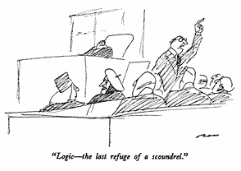
Logic and People
9.1 Introduction
9.2 Well-formed Formulas for First-order Predicate Logic-syntax Rules
9.3 Satisfiable, unsatisfiable and valid WFF
9.4 Equivalence
9.5 Computable functions and predicate logic
9.6 Resolution
9.7 Conversion to clause form
9.7.1 Algorithm
9.7.2 Example
9.8 First-order logic
9.9 Knowledge engineering of FOL
9.10 Unification
9.11 Natural Deduction
People can easily be confused by logic
And are often suspicious of it, or give it too much weight

Slide 36
Example: A simple genealogy KB by FOL
9.1 Introduction
9.2 Well-formed Formulas for First-order Predicate Logic-syntax Rules
9.3 Satisfiable, unsatisfiable and valid WFF
9.4 Equivalence
9.5 Computable functions and predicate logic
9.6 Resolution
9.7 Conversion to clause form
9.7.1 Algorithm
9.7.2 Example
9.8 First-order logic
9.9 Knowledge engineering of FOL
9.10 Unification
9.11 Natural Deduction
Build a small genealogy knowledge base using FOL that
contains facts of immediate family relations (spouses, parents, etc.)
contains definitions of more complex relations (ancestors, relatives)
is able to answer queries about relationships between people
Predicates:
parent(x, y), child(x, y), father(x, y), daughter(x, y), etc.
spouse(x, y), husband(x, y), wife(x,y)
ancestor(x, y), descendant(x, y)
male(x), female(y)
relative(x, y)
Facts:
husband(Joe, Mary), son(Fred, Joe)
spouse(John, Nancy), male(John), son(Mark, Nancy)
father(Jack, Nancy), daughter(Linda, Jack)
daughter(Liz, Linda)
etc.

Slide 37
9.1 Introduction
9.2 Well-formed Formulas for First-order Predicate Logic-syntax Rules
9.3 Satisfiable, unsatisfiable and valid WFF
9.4 Equivalence
9.5 Computable functions and predicate logic
9.6 Resolution
9.7 Conversion to clause form
9.7.1 Algorithm
9.7.2 Example
9.8 First-order logic
9.9 Knowledge engineering of FOL
9.10 Unification
9.11 Natural Deduction
Rules for genealogical relations
(∀x,y) parent(x, y) ↔ child (y, x)
(∀x,y) father(x, y) ↔ parent(x, y) ∧ male(x) ;similarly for mother(x, y)
(∀x,y) daughter(x, y) ↔ child(x, y) ∧ female(x) ;similarly for son(x, y)
(∀x,y) husband(x, y) ↔ spouse(x, y) ∧ male(x) ;similarly for wife(x, y)
(∀x,y) spouse(x, y) ↔ spouse(y, x) ;spouse relation is symmetric
(∀x,y) parent(x, y) → ancestor(x, y)
(∀x,y)(∃z) parent(x, z) ∧ ancestor(z, y) → ancestor(x, y)
(∀x,y) descendant(x, y) ↔ ancestor(y, x)
(∀x,y)(∃z) ancestor(z, x) ∧ ancestor(z, y) → relative(x, y)
;related by common ancestry
(∀x,y) spouse(x, y) → relative(x, y) ;related by marriage
(∀x,y)(∃z) relative(z, x) ∧ relative(z, y) → relative(x, y) ;transitive
(∀x,y) relative(x, y) ↔ relative(y, x) ;symmetric
Queries
ancestor(Jack, Fred) ; the answer is yes
relative(Liz, Joe) ; the answer is yes
relative(Nancy, Matthew)
;no answer in general, no if under closed world assumption
(∃z) ancestor(z, Fred) ∧ ancestor(z, Liz)

Slide 38
Axioms for Set Theory in FOL
9.1 Introduction
9.2 Well-formed Formulas for First-order Predicate Logic-syntax Rules
9.3 Satisfiable, unsatisfiable and valid WFF
9.4 Equivalence
9.5 Computable functions and predicate logic
9.6 Resolution
9.7 Conversion to clause form
9.7.1 Algorithm
9.7.2 Example
9.8 First-order logic
9.9 Knowledge engineering of FOL
9.10 Unification
9.11 Natural Deduction
1. The only sets are the empty set and those made by adjoining something to a set:
∀s set(s) <=> (s=EmptySet) v (∃x,r Set(r) ^ s=Adjoin(s,r))
2. The empty set has no elements adjoined to it:
~ ∃x,s Adjoin(x,s)=EmptySet
3. Adjoining an element already in the set has no effect:
∀x,s Member(x,s) <=> s=Adjoin(x,s)
4. The only members of a set are the elements that were adjoined into it:
∀x,s Member(x,s) <=> ∃y,r (s=Adjoin(y,r) ^ (x=y ∨ Member(x,r)))
5. A set is a subset of another iff all of the 1st set’s members are members of the 2nd:
∀s,r Subset(s,r) <=> (∀x Member(x,s) => Member(x,r))
6. Two sets are equal iff each is a subset of the other:
∀s,r (s=r) <=> (subset(s,r) ^ subset(r,s))
7. Intersection
∀x,s1,s2 member(X,intersection(S1,S2)) <=> member(X,s1) ^ member(X,s2)
8. Union
∃x,s1,s2 member(X,union(s1,s2)) <=> member(X,s1) ∨ member(X,s2)

Slide 39
Semantics of FOL
9.1 Introduction
9.2 Well-formed Formulas for First-order Predicate Logic-syntax Rules
9.3 Satisfiable, unsatisfiable and valid WFF
9.4 Equivalence
9.5 Computable functions and predicate logic
9.6 Resolution
9.7 Conversion to clause form
9.7.1 Algorithm
9.7.2 Example
9.8 First-order logic
9.9 Knowledge engineering of FOL
9.10 Unification
9.11 Natural Deduction
Domain M: the set of all objects in the world (of interest)
Interpretation I: includes
Assign each constant to an object in M
Define each function of n arguments as a mapping M^{n} => M
Define each predicate of n arguments as a mapping M^{n} => {T, F}
Therefore, every ground predicate with any instantiation will have a truth value
In general there is an infinite number of interpretations because |M| is infinite
Define logical connectives: ~, ^, v, =>, <=> as in PL
Define semantics of (∀x) and (∃x)
(∀x) P(x) is true iff P(x) is true under all interpretations
(∃x) P(x) is true iff P(x) is true under some interpretation

Slide 40
9.1 Introduction
9.2 Well-formed Formulas for First-order Predicate Logic-syntax Rules
9.3 Satisfiable, unsatisfiable and valid WFF
9.4 Equivalence
9.5 Computable functions and predicate logic
9.6 Resolution
9.7 Conversion to clause form
9.7.1 Algorithm
9.7.2 Example
9.8 First-order logic
9.9 Knowledge engineering of FOL
9.10 Unification
9.11 Natural Deduction
Model: an interpretation of a set of sentences such that every sentence is True
A sentence is
satisfiable if it is true under some interpretation
valid if it is true under all possible interpretations
inconsistent if there does not exist any interpretation under which the sentence is true
Logical consequence: S |= X if all models of S are also models of X

Slide 41
Axioms, definitions and theorems
9.1 Introduction
9.2 Well-formed Formulas for First-order Predicate Logic-syntax Rules
9.3 Satisfiable, unsatisfiable and valid WFF
9.4 Equivalence
9.5 Computable functions and predicate logic
9.6 Resolution
9.7 Conversion to clause form
9.7.1 Algorithm
9.7.2 Example
9.8 First-order logic
9.9 Knowledge engineering of FOL
9.10 Unification
9.11 Natural Deduction
Axioms are facts and rules that attempt to capture all of the (important) facts and concepts about a domain; axioms can be used to prove theorems
Mathematicians don’t want any unnecessary (dependent) axioms, i.e. ones that can be derived from other axioms
Dependent axioms can make reasoning faster, however
Choosing a good set of axioms for a domain is a design problem
A definition of a predicate is of the form “p(X) ↔ …” and can be decomposed into two parts
Necessary description: “p(x) → …”
Sufficient description “p(x) ← …”
Some concepts don’t have complete definitions (e.g., person(x))

Slide 42
More on definitions
9.1 Introduction
9.2 Well-formed Formulas for First-order Predicate Logic-syntax Rules
9.3 Satisfiable, unsatisfiable and valid WFF
9.4 Equivalence
9.5 Computable functions and predicate logic
9.6 Resolution
9.7 Conversion to clause form
9.7.1 Algorithm
9.7.2 Example
9.8 First-order logic
9.9 Knowledge engineering of FOL
9.10 Unification
9.11 Natural Deduction
Example: define father(x, y) by parent(x, y) and male(x)
parent(x, y) is a necessary (but not sufficient) description of father(x, y)
father(x, y) → parent(x, y)
parent(x, y) ^ male(x) ^ age(x, 35) is a sufficient (but not necessary) description of father(x, y):
father(x, y) ← parent(x, y) ^ male(x) ^ age(x, 35)
parent(x, y) ^ male(x) is a necessary and sufficient description of father(x, y)
parent(x, y) ^ male(x) ↔ father(x, y)

Slide 43
Higher-order logic
9.1 Introduction
9.2 Well-formed Formulas for First-order Predicate Logic-syntax Rules
9.3 Satisfiable, unsatisfiable and valid WFF
9.4 Equivalence
9.5 Computable functions and predicate logic
9.6 Resolution
9.7 Conversion to clause form
9.7.1 Algorithm
9.7.2 Example
9.8 First-order logic
9.9 Knowledge engineering of FOL
9.10 Unification
9.11 Natural Deduction
FOL only allows to quantify over variables, and variables can only range over objects.
HOL allows us to quantify over relations
Example: (quantify over functions)
“two functions are equal iff they produce the same value for all arguments”
∀f ∀g (f = g) ↔ (∀x f(x) = g(x))
Example: (quantify over predicates)
∀r transitive( r ) → (∀xyz) r(x,y) ∧ r(y,z) → r(x,z))
More expressive, but undecidable, in general

Slide 44
Expressing uniqueness
9.1 Introduction
9.2 Well-formed Formulas for First-order Predicate Logic-syntax Rules
9.3 Satisfiable, unsatisfiable and valid WFF
9.4 Equivalence
9.5 Computable functions and predicate logic
9.6 Resolution
9.7 Conversion to clause form
9.7.1 Algorithm
9.7.2 Example
9.8 First-order logic
9.9 Knowledge engineering of FOL
9.10 Unification
9.11 Natural Deduction
Sometimes we want to say that there is a single, unique object that satisfies a certain condition
“There exists a unique x such that king(x) is true”
∃x king(x) ∧ ∀y (king(y) → x=y)
∃x king(x) ∧ ¬∃y (king(y) ∧ x≠y)
∃! x king(x)
“Every country has exactly one ruler”
∀c country(c) → ∃! r ruler(c,r)
Iota operator: “ι x P(x)” means “the unique x such that p(x) is true”
“The unique ruler of Freedonia is dead”
dead(ι x ruler(freedonia,x))

Slide 45
Notational differences
9.1 Introduction
9.2 Well-formed Formulas for First-order Predicate Logic-syntax Rules
9.3 Satisfiable, unsatisfiable and valid WFF
9.4 Equivalence
9.5 Computable functions and predicate logic
9.6 Resolution
9.7 Conversion to clause form
9.7.1 Algorithm
9.7.2 Example
9.8 First-order logic
9.9 Knowledge engineering of FOL
9.10 Unification
9.11 Natural Deduction
Different symbols for and, or, not, implies, ...
∀ ∃ ⇒ ⇔ ∧ ∨ ¬ • ⊃
p v (q ^ r)
p + (q * r)
etc
Prolog
cat(X) :- furry(X), meows (X), has(X, claws)
Lispy notations
(forall ?x (implies (and (furry ?x)
(meows ?x)
(has ?x claws))
(cat ?x)))

Slide 46
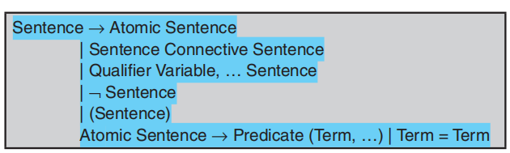
Well-formed Formulas for First-order Predicate Logic-syntax Rules
9.1 Introduction
9.2 Well-formed Formulas for First-order Predicate Logic-syntax Rules
9.3 Satisfiable, unsatisfiable and valid WFF
9.4 Equivalence
9.5 Computable functions and predicate logic
9.6 Resolution
9.7 Conversion to clause form
9.7.1 Algorithm
9.7.2 Example
9.8 First-order logic
9.9 Knowledge engineering of FOL
9.10 Unification
9.11 Natural Deduction

Slide 47
Satisfiable, unsatisfiable and valid WFFs
9.1 Introduction
9.2 Well-formed Formulas for First-order Predicate Logic-syntax Rules
9.3 Satisfiable, unsatisfiable and valid WFF
9.4 Equivalence
9.5 Computable functions and predicate logic
9.6 Resolution
9.7 Conversion to clause form
9.7.1 Algorithm
9.7.2 Example
9.8 First-order logic
9.9 Knowledge engineering of FOL
9.10 Unification
9.11 Natural Deduction
A WFF is said to be satisfiable, if there exist an interpretation that makes it true. This means that there are: a universe, specific predicates assigned to the predicates variables and an assignments values to the free variables that make the WFF true.
For example, ∀ x N(x), where N(x) means that x is nonnegative, and is satisfiable. For if the universe is the set of natural numbers, the assertion ∀ x N(x) is true, because all the natural numbers are nonnegative. Similarly, ∃x N(x) is also satisfiable.
However, ∀x [N(x) ∧ ⌐N(x)] is not satisfiable because it can never be true. A WFF is called invalid or unsatisfiable, if there is not interpretation that makes it true
A WFF is valid if it is true for every interpretation.
For example, the WFF ∀x P(x) ∨ ∃x P(x) is valid for any predicate name P, because ∃x ⌐P(x) is negative of ∀x P(x). However, the WFF ∀x N(x) is satisfiable but not valid.

Slide 48
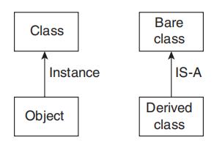
Equivalence
9.1 Introduction
9.2 Well-formed Formulas for First-order Predicate Logic-syntax Rules
9.3 Satisfiable, unsatisfiable and valid WFF
9.4 Equivalence
9.5 Computable functions and predicate logic
9.6 Resolution
9.7 Conversion to clause form
9.7.1 Algorithm
9.7.2 Example
9.8 First-order logic
9.9 Knowledge engineering of FOL
9.10 Unification
9.11 Natural Deduction
Two WFFs W1 and W2 are equivalent if and only if W1↔W2 is valid, that is, if and only if W1↔W2 is true for all interpretations. For example, ∀x P(x) and ⌐ ∃x P(x) are equivalent for any predicate name P. So are ∀x [P(x) ∧ Q(x)] and [∀x P(x) ∧ ∀x Q(x)] for any predicate names P and Q.
Is_a relationship in predicate logic
A relationship between a class and it object is termed as a instance relationship. Also, the relationship between the class and subclass is termed as Is_a relationship.

Slide 49
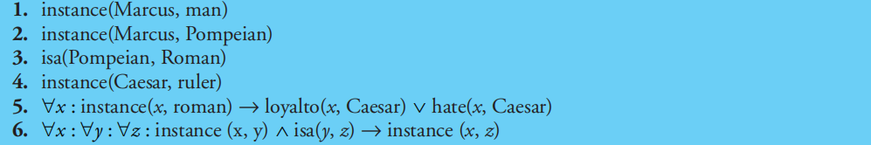
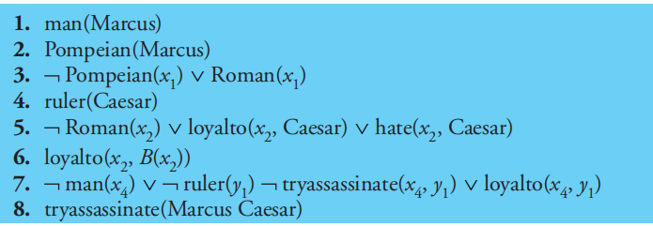
Equivalence
9.1 Introduction
9.2 Well-formed Formulas for First-order Predicate Logic-syntax Rules
9.3 Satisfiable, unsatisfiable and valid WFF
9.4 Equivalence
9.5 Computable functions and predicate logic
9.6 Resolution
9.7 Conversion to clause form
9.7.1 Algorithm
9.7.2 Example
9.8 First-order logic
9.9 Knowledge engineering of FOL
9.10 Unification
9.11 Natural Deduction
EXAMPLE:
Axioms in clause form

Slide 50
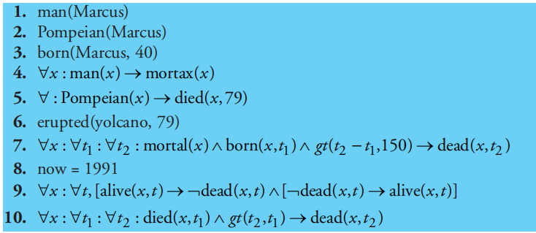
Computable functions and predicate logic
9.1 Introduction
9.2 Well-formed Formulas for First-order Predicate Logic-syntax Rules
9.3 Satisfiable, unsatisfiable and valid WFF
9.4 Equivalence
9.5 Computable functions and predicate logic
9.6 Resolution
9.7 Conversion to clause form
9.7.1 Algorithm
9.7.2 Example
9.8 First-order logic
9.9 Knowledge engineering of FOL
9.10 Unification
9.11 Natural Deduction
EXAMPLE:
Facts about Marcus

Slide 51
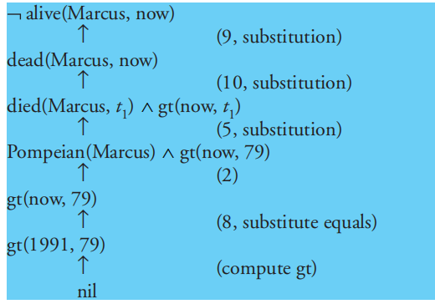
Computable functions and predicate logic
9.1 Introduction
9.2 Well-formed Formulas for First-order Predicate Logic-syntax Rules
9.3 Satisfiable, unsatisfiable and valid WFF
9.4 Equivalence
9.5 Computable functions and predicate logic
9.6 Resolution
9.7 Conversion to clause form
9.7.1 Algorithm
9.7.2 Example
9.8 First-order logic
9.9 Knowledge engineering of FOL
9.10 Unification
9.11 Natural Deduction
One way of proving Marcus is dead

Slide 52
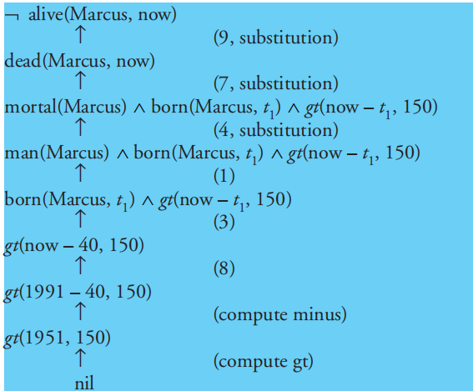
Resolution
9.1 Introduction
9.2 Well-formed Formulas for First-order Predicate Logic-syntax Rules
9.3 Satisfiable, unsatisfiable and valid WFF
9.4 Equivalence
9.5 Computable functions and predicate logic
9.6 Resolution
9.7 Conversion to clause form
9.7.1 Algorithm
9.7.2 Example
9.8 First-order logic
9.9 Knowledge engineering of FOL
9.10 Unification
9.11 Natural Deduction
Resolution is such a procedure, which gains its efficiency from the fact that it operates on statements that have been converted to a very convenient standard form.
Another way of proving Marcus is dead

Slide 53
Conversion to clause form
9.1 Introduction
9.2 Well-formed Formulas for First-order Predicate Logic-syntax Rules
9.3 Satisfiable, unsatisfiable and valid WFF
9.4 Equivalence
9.5 Computable functions and predicate logic
9.6 Resolution
9.7 Conversion to clause form
9.7.1 Algorithm
9.7.2 Example
9.8 First-order logic
9.9 Knowledge engineering of FOL
9.10 Unification
9.11 Natural Deduction
ALGORITHM:
Eliminate → using the fact that a → b is equivalent to ¬ a V b. Performing this transformation on the WFF given higher than yields.
Reduce the scope of each ¬ to a single term, using the fact that ¬ (¬ p) = p, deMorgan’s laws [which say that ¬ (a ∧ b) = ¬ a V ¬ b and ¬ (a V b) = ¬ a ∧¬ b], and the standard correspondences between quantifiers [¬ ∀x: P(x) = ∃x: ¬ P(x) and ¬ ∃x: P(x) = ∀x: ¬P(x)].
Standardise variables so every quantifier binds a singular variable. Since, variables square measure simply dummy names, this method cannot have an effect on the reality worth of the WFF.
Move all quantifiers to the left of the formula while not dynamical their relative order. This is attainable since there is no conflict among variable names.

Slide 54
Conversion to clause form
9.1 Introduction
9.2 Well-formed Formulas for First-order Predicate Logic-syntax Rules
9.3 Satisfiable, unsatisfiable and valid WFF
9.4 Equivalence
9.5 Computable functions and predicate logic
9.6 Resolution
9.7 Conversion to clause form
9.7.1 Algorithm
9.7.2 Example
9.8 First-order logic
9.9 Knowledge engineering of FOL
9.10 Unification
9.11 Natural Deduction
5. Eliminate existential quantifiers. A formula that contains Associate in Nursing existentially quantified variable asserts that there’s a price which will be substituted for the variable that produces the formula true. We can eliminate the quantifier by substituting for the variable a reference to a function that produces the desired value. We create no assertions concerning these functions except that they need to exist.
6. Drop the prefix. At this time, all remaining variables are universally quantified, therefore the prefix will simply be born and any proof procedure we have a tendency to use will merely assume that any variable it sees is universally quantified.
7. Convert the matrix into a conjunction of disjuncts.
8. Produce a separate clause reminiscent of every conjunct. In order for a WFF to be true, all the clauses that are generated from it should be true.

Slide 55
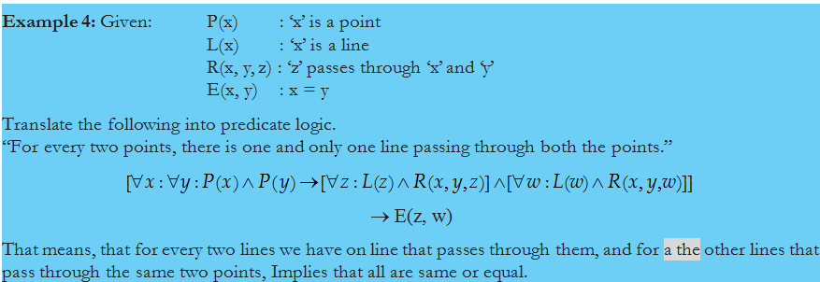
Conversion to clause form
9.1 Introduction
9.2 Well-formed Formulas for First-order Predicate Logic-syntax Rules
9.3 Satisfiable, unsatisfiable and valid WFF
9.4 Equivalence
9.5 Computable functions and predicate logic
9.6 Resolution
9.7 Conversion to clause form
9.7.1 Algorithm
9.7.2 Example
9.8 First-order logic
9.9 Knowledge engineering of FOL
9.10 Unification
9.11 Natural Deduction
9. Standardize apart the variables within the set of clauses generated in step eight. By this we have a tendency to mean rename the variables in order that no 2 clauses create relevance a similar variable.
Example:

Slide 56
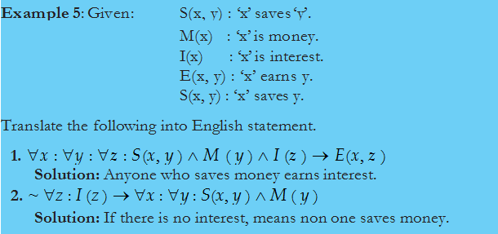
Conversion to clause form
9.1 Introduction
9.2 Well-formed Formulas for First-order Predicate Logic-syntax Rules
9.3 Satisfiable, unsatisfiable and valid WFF
9.4 Equivalence
9.5 Computable functions and predicate logic
9.6 Resolution
9.7 Conversion to clause form
9.7.1 Algorithm
9.7.2 Example
9.8 First-order logic
9.9 Knowledge engineering of FOL
9.10 Unification
9.11 Natural Deduction

Slide 57
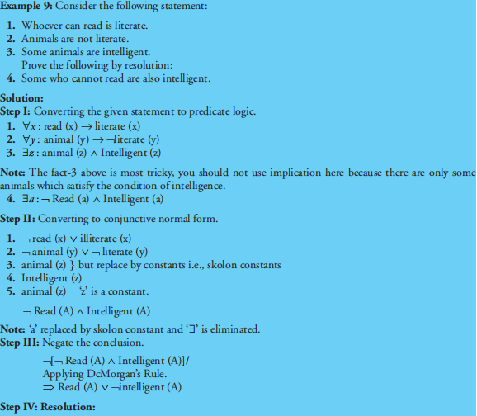
Conversion to clause form
9.1 Introduction
9.2 Well-formed Formulas for First-order Predicate Logic-syntax Rules
9.3 Satisfiable, unsatisfiable and valid WFF
9.4 Equivalence
9.5 Computable functions and predicate logic
9.6 Resolution
9.7 Conversion to clause form
9.7.1 Algorithm
9.7.2 Example
9.8 First-order logic
9.9 Knowledge engineering of FOL
9.10 Unification
9.11 Natural Deduction

Slide 58
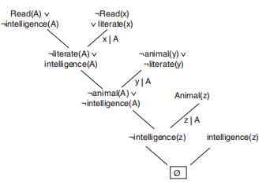
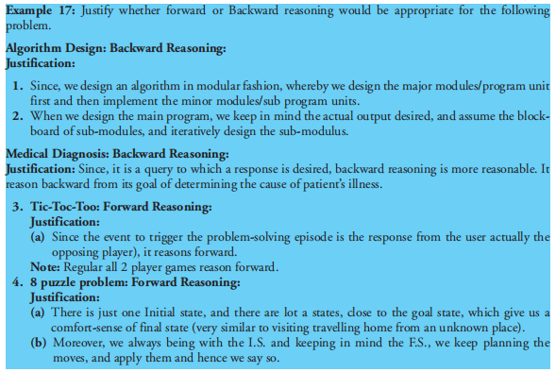
Conversion to clause form
9.1 Introduction
9.2 Well-formed Formulas for First-order Predicate Logic-syntax Rules
9.3 Satisfiable, unsatisfiable and valid WFF
9.4 Equivalence
9.5 Computable functions and predicate logic
9.6 Resolution
9.7 Conversion to clause form
9.7.1 Algorithm
9.7.2 Example
9.8 First-order logic
9.9 Knowledge engineering of FOL
9.10 Unification
9.11 Natural Deduction

Slide 59
First-order logic
9.1 Introduction
9.2 Well-formed Formulas for First-order Predicate Logic-syntax Rules
9.3 Satisfiable, unsatisfiable and valid WFF
9.4 Equivalence
9.5 Computable functions and predicate logic
9.6 Resolution
9.7 Conversion to clause form
9.7.1 Algorithm
9.7.2 Example
9.8 First-order logic
9.9 Knowledge engineering of FOL
9.10 Unification
9.11 Natural Deduction
The prepositional logic only deals with the facts, which may be true or false.
The first order logic assumes that the world contains objects, relations and functions.
Syntax
In prepositional logic, every expression is a sentence that represents a fact.
First order logic includes the sentences along with terms that can represent the objects.
Constant symbols, variables and function symbols are used to build terms, while quantifiers and predicate symbols are used to build the sentences.

Slide 60
Knowledge engineering of FOL
9.1 Introduction
9.2 Well-formed Formulas for First-order Predicate Logic-syntax Rules
9.3 Satisfiable, unsatisfiable and valid WFF
9.4 Equivalence
9.5 Computable functions and predicate logic
9.6 Resolution
9.7 Conversion to clause form
9.7.1 Algorithm
9.7.2 Example
9.8 First-order logic
9.9 Knowledge engineering of FOL
9.10 Unification
9.11 Natural Deduction
The knowledge engineer must know about the domain to represent the important objects and relationships. The following steps are used to develop the knowledge base:
Identify the problem or task.
Assemble the relevant knowledge to the given problem or task.
Decide on a vocabulary of predicates, functions and constants.
Encode the general knowledge about the domain and a description of the specific problem instance.
Apply queries to the inference procedure and get the answers.
Finally, debug the knowledge base.

Slide 61
Knowledge engineering in FOL
9.1 Introduction
9.2 Well-formed Formulas for First-order Predicate Logic-syntax Rules
9.3 Satisfiable, unsatisfiable and valid WFF
9.4 Equivalence
9.5 Computable functions and predicate logic
9.6 Resolution
9.7 Conversion to clause form
9.7.1 Algorithm
9.7.2 Example
9.8 First-order logic
9.9 Knowledge engineering of FOL
9.10 Unification
9.11 Natural Deduction
Consider the following english text:
“Anyone passing his Intelligent System exam and winning the lottery is happy. But any student who studies for an exam or is lucky can pass all his exams. John did not study but John is lucky. Anyone who is lucky wins the lottery. Mary did not win the lottery, however Mary passed her IS exam. Gary won the lottery. Gary, John, and Mary are all students.„
Is John happy?
Is Mary happy? Is she lucky?
Did every student pass the IS exam?

Slide 62
Formalization in FOL
9.1 Introduction
9.2 Well-formed Formulas for First-order Predicate Logic-syntax Rules
9.3 Satisfiable, unsatisfiable and valid WFF
9.4 Equivalence
9.5 Computable functions and predicate logic
9.6 Resolution
9.7 Conversion to clause form
9.7.1 Algorithm
9.7.2 Example
9.8 First-order logic
9.9 Knowledge engineering of FOL
9.10 Unification
9.11 Natural Deduction
Identify the task
Knowledge to be captured, questions to be answered
Assemble the relevant knowledge
Relavant: Relation between exams, lottery jackpots, passing of an exam information about individuals, etc.
Irrelevant: Dates of exams, teacher of the exam, amount of money in the lottery pot, etc.
Decide on a vocabulary
Predicates
Constants symbols
E.g. Win(x, Lottery) or Win(x, y) ∧ Lottery(y)?

Slide 63
Formalization in FOL (cont’)
9.1 Introduction
9.2 Well-formed Formulas for First-order Predicate Logic-syntax Rules
9.3 Satisfiable, unsatisfiable and valid WFF
9.4 Equivalence
9.5 Computable functions and predicate logic
9.6 Resolution
9.7 Conversion to clause form
9.7.1 Algorithm
9.7.2 Example
9.8 First-order logic
9.9 Knowledge engineering of FOL
9.10 Unification
9.11 Natural Deduction
Encode general knowledge of the domain
Anyone passing the IS exams and winning the lottery is happy
∀x Pass(x, IS) ∧ Win(x, Lottery) ⇒ Happy(x)
Any student who studies or is lucky can pass all his exams
∀x ∀y Student(x) ∧ Exam(y) ∧ (StudiesFor(x, y) ∨ Lucky(x)) ⇒ Pass(x,y)
Anyone who is lucky wins the lottery
∀x Lucky(x) ⇒ Win(x, Lottery)

Slide 64
Formalization in FOL (cont’)
9.1 Introduction
9.2 Well-formed Formulas for First-order Predicate Logic-syntax Rules
9.3 Satisfiable, unsatisfiable and valid WFF
9.4 Equivalence
9.5 Computable functions and predicate logic
9.6 Resolution
9.7 Conversion to clause form
9.7.1 Algorithm
9.7.2 Example
9.8 First-order logic
9.9 Knowledge engineering of FOL
9.10 Unification
9.11 Natural Deduction
Encode the specific problem instance
John did not study, but John is lucky
¬Study(John) ∧ Lucky(John)
Mary did not win the lottery, however Mary passed her IS exam ¬ Win(Mary, Lottery)
Pass(Mary,IS)
Gary won the lottery
Win(Gary, Lottery)
Gary, John, and Mary are all students
Student(Gary), Student(John), Student(Mary)

Slide 65
Formalization in FOL (cont’)
9.1 Introduction
9.2 Well-formed Formulas for First-order Predicate Logic-syntax Rules
9.3 Satisfiable, unsatisfiable and valid WFF
9.4 Equivalence
9.5 Computable functions and predicate logic
9.6 Resolution
9.7 Conversion to clause form
9.7.1 Algorithm
9.7.2 Example
9.8 First-order logic
9.9 Knowledge engineering of FOL
9.10 Unification
9.11 Natural Deduction
6. Pose queries to the inference procedure
Is John happy?
Happy(John) ?
Is Mary happy? Is she lucky?
Happy(Mary), Lucky(Mary)?
Did every student pass the IS exam?
∃x Student(x) ∧ Pass(x, IS) ?
Specific inference procedures (e.g. Resolution) can be used to systematically answer those queries (see next lecture)

Slide 66
Unification
9.1 Introduction
9.2 Well-formed Formulas for First-order Predicate Logic-syntax Rules
9.3 Satisfiable, unsatisfiable and valid WFF
9.4 Equivalence
9.5 Computable functions and predicate logic
9.6 Resolution
9.7 Conversion to clause form
9.7.1 Algorithm
9.7.2 Example
9.8 First-order logic
9.9 Knowledge engineering of FOL
9.10 Unification
9.11 Natural Deduction
In propositional calculus, it is simple to work out that two literals cannot each be true at a similar time. Simply hunt for L and ¬ L in predicate logic, this matching method is a lot of difficult since the arguments of the predicates should be thought of.
For example, man(John) and ¬ man(John) is a contradiction, while man(John) and ¬ man(Spot) is not. Thus, so as to work out contradictions, we want an identical procedure that compares two literals and discovers whether or not there exists a group of substitutions that produces them identical. There is an easy algorithmic procedure known as the unification algorithmic rule that does just this. The basic idea of unification is very simple.
ALGORITHM: Unify(L1, L2)
If L1 or L2 are both variables or constants, then:
If L1 and L2 are identical, then return NIL.

Slide 67
Unification
9.1 Introduction
9.2 Well-formed Formulas for First-order Predicate Logic-syntax Rules
9.3 Satisfiable, unsatisfiable and valid WFF
9.4 Equivalence
9.5 Computable functions and predicate logic
9.6 Resolution
9.7 Conversion to clause form
9.7.1 Algorithm
9.7.2 Example
9.8 First-order logic
9.9 Knowledge engineering of FOL
9.10 Unification
9.11 Natural Deduction
Else if L1 is a variable, then if L1 occurs in L2 then return {FAIL}, else return (L2/L1).
Else if L2 is a variable, then if L2 occurs in L1 then return {FAIL}, else return (L1/L2).
Else return {FAIL}.
2. If the initial predicate symbols in L1 and L2 are not identical, then return {FAIL}.
3. If LI and L2 have a different number of arguments, then return {FAIL}.
4. Set SUBST to NIL. (At the end of this procedure, SUBST will contain all the substitutions used to unify L1 and L2.)
5. For i ¬ 1 to number of arguments in L1:
Call Unify with the ith argument of L1 and the ith argument of L2, putting result in S.

Slide 68
Unification
9.1 Introduction
9.2 Well-formed Formulas for First-order Predicate Logic-syntax Rules
9.3 Satisfiable, unsatisfiable and valid WFF
9.4 Equivalence
9.5 Computable functions and predicate logic
9.6 Resolution
9.7 Conversion to clause form
9.7.1 Algorithm
9.7.2 Example
9.8 First-order logic
9.9 Knowledge engineering of FOL
9.10 Unification
9.11 Natural Deduction
If S contains FAIL then return {FAIL}.
If S is not equal to NIL then:
Apply S to the remainder of both L1 and L2.
SUBST: = APPEND(S, SUBST).
6. Return SUBST
Natural deduction
Natural deduction is not a precise term. Rather it describes as mélange of techniques, used in combination to solve problems that are not tractable by any one method alone. One common technique is to arrange knowledge, not by predicates, as we have been doing, but rather by the objects involved in the predicates. Technique is to use a set of rewrite rules that not only describe logical implications but also suggest the way that those implications can be exploited in proofs

Slide 69

Dr. Nilakshi Jain Email ID : nilakshijain1986@gmail.com
Thank you

